Slide 1
RR BAWA DAV COLLEGE FOR GIRLS BATALA
Department of Sociology
Syllabus for the Session 2024-25

Slide 2
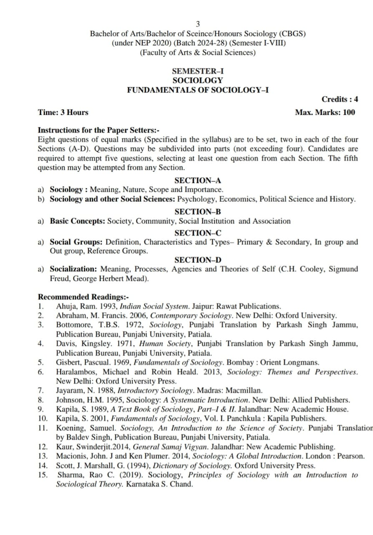

Slide 3
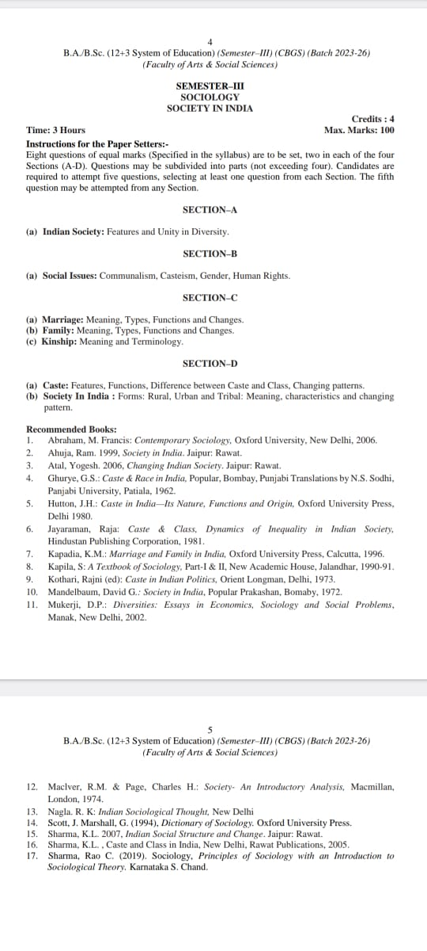

Slide 4
